Slide 1
Innovative test solution
Provider

Slide 2
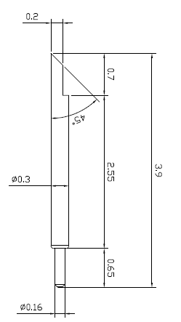
※ POGO type – Kelvin solution (0.4 pitch)
IVB-SCR-390-030-A141-00
Pitch | 0.40mm
Total Length | 3.9mm
Use Length | 3.45mm
Use Stroke | 0.45mm
Recommended Top Plunger Stroke | 0.20mm
Recommended Bottom Plunger Stroke (Pre-load) | 0.25mm
Max Stroke | 0.5mm
Spring Force at Use Stroke | 22gf at 0.45mm Stroke
Operating Temperature | -40 to 120°C
DC Resistance | Avg. 50.0mΩ at 0.45mm stroke
Current Rating | 1.5A
Self Inductance | 1.10nH
Bandwidth @ -1dB | 26.5GHz
Top Plunger | Hardened BeCu / Au Plated
Bottom Plunger | Hardened BeCu / Au Alloy Plated
Barrel | Alloy / Au Plated
Spring | Music Wire / Au Plated
Insertion Life | 100,000 cycles at 0.45mm Stroke

Slide 3
Thank you.

